Slide 1
Tom & Jerry
PURPLE DAY

Slide 2
And the winner is….

Slide 3
RED TEAM

Slide 4
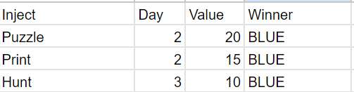
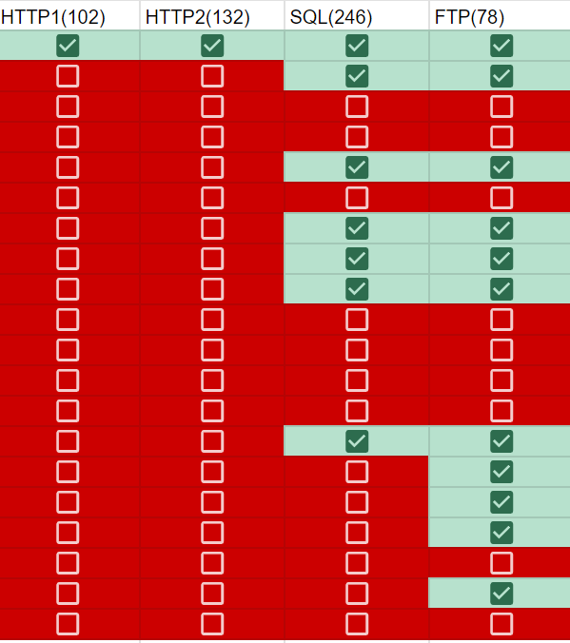
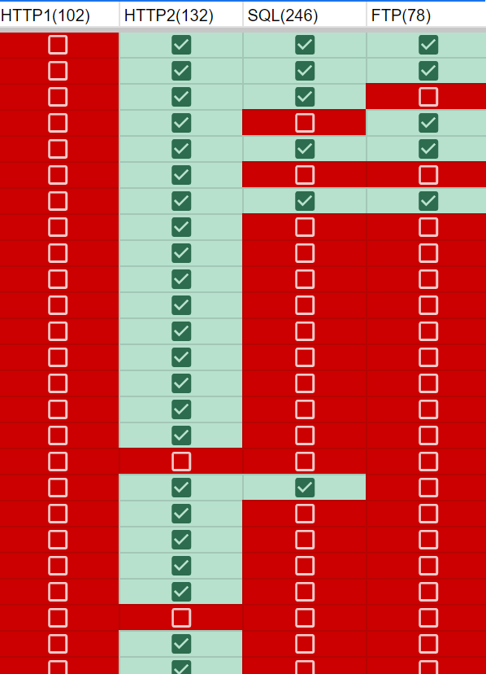
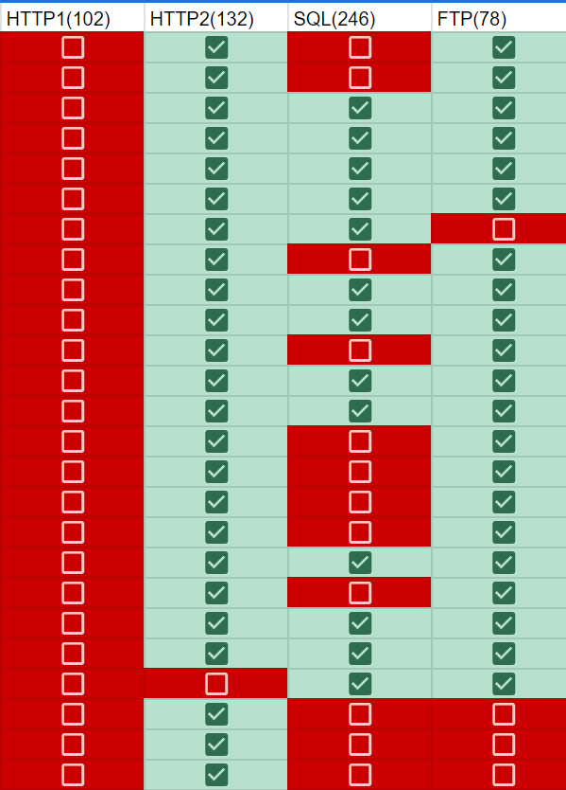
Final Scores
Injects
Flags
77 Total Points
40 Points Found
37 Points Not Found
Red: 205
Blue: 194
Day 1 Day 2 Day 3

Slide 5
THANKS!

